Slide 1



Ethical AI according to EU
Presentation by Cloë and Zaur

Slide 2
What constitutes ‘ethic AI’ to the EU?
We have 3 branches of ethical AI, according to the EU[1]:
(1) Lawful - The ethical AI must be respectful of all applicable laws and regulations
(2) Ethical - It must be respectful of ethical all common principles and values.
These include: human autonomy, prevention of harm, fairness, and explicability
(3) Robust - This should be from a technical perspective while taking into account its social environment, this is the human-centered approach

Slide 3
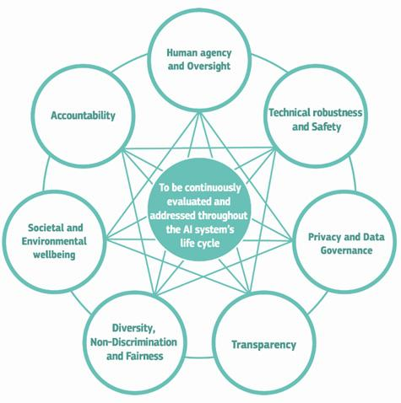
What are the guidelines / principles they are offering?
The European Commision provides a guideline[2] with 7 key requirements for AI:
fostering fundamental rights, human-in-the-loop and human-in-command
mechanisms should be in place to ensure responsibility for outcomes
resilient and secure
data should be protected and ensured of quality and integrity
must be sustainable for future generations
decisions should be explained to stakeholder and humans must be aware that they are talking to an AI and know its limitations
bias must be avoided and AI must be accessible to all

Slide 4

What are the main ethics/values the guideline(s) emphasis on ?
There are a number of ethical values that they emphasize[3], these include:
Respect for human autonomy - (Human dignity aspect)
Prevention of harm - (Ten Commandments of Computer Ethics: Commandment 1)
Fairness - Fair to all
Explicability and transparency - Understandable decision-making
Robustness and safety - Not easy to break/hack
Privacy and data protection - Secure data/information
Societal and environmental well-being - Not a sustainability issue
Notes:
https://www.abzu.ai/blog/the-european-approach-towards-trustworthy-ai/#:~:text=In%20a%20nutshell%3A%20Trustworthy%20AI,%2C%20fairness%2C%20and%20explicability.%20%5B

Slide 5
What are the ethical requirements, technical standards and best practices are needed for ethical AI
To keep the system trustworthy include a “white list” of rules (behaviours or states) that the system should always follow and “black list” restrictions regarding the system’s behaviour
They have developed a Trustworthy AI Assessment List (Pilot Version) which essentially aims to access weather the AI complies with the Ethical Requirements set forth by the EU (also including state laws)
XAI is important, for explanation to stakeholders so a full and clear understanding of the decision-making process and expectations of the AI
source: [2]

Slide 6
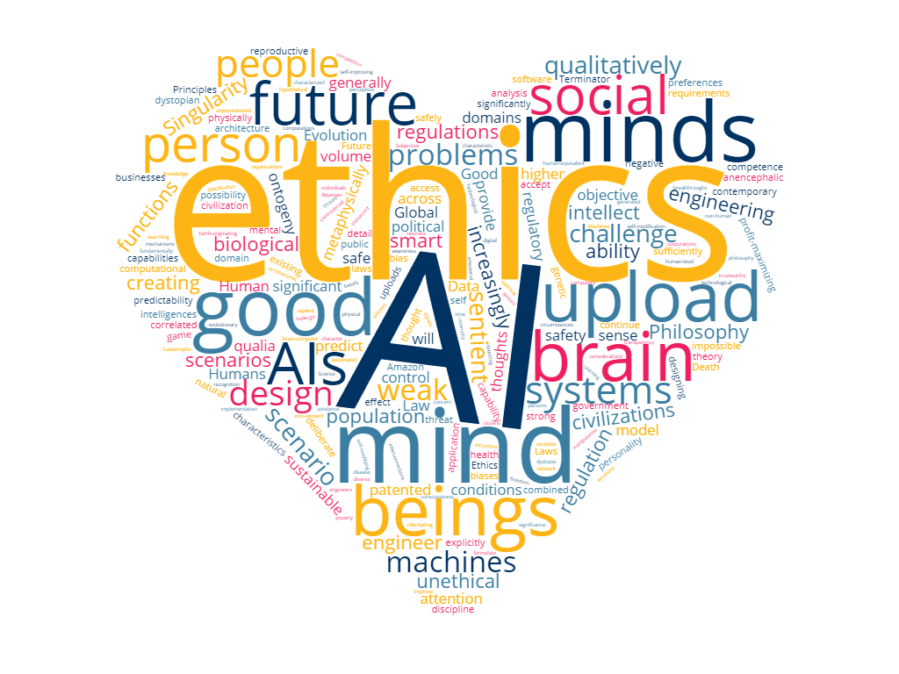
What is the progress/achievement so far?
There have been a number of achievements and progressive influences,
such as:
It has influenced the Artificial intelligence - ISO/IEC 23894:2023 [4]
It has influenced Singapore’s AI Governance Framework at the World Economic Forum in Davos [5]
It has created and initiated many university and research institutions to study Ethical AI, such as the HCAIM (The HCAIM program that we are studying)

Slide 7
References
[1]https://digital-strategy.ec.europa.eu/en/library/ethics-guidelines-trustworthy-ai
[2]https://ec.europa.eu/futurium/en/ai-alliance-consultation.1.html#:~:text=Based%20on%20fundamental%20rights%20and,Privacy%20and%20Data%20governance
[3]https://www.abzu.ai/blog/the-european-approach-towards-trustworthy-ai/#:~:text=In%20a%20nutshell%3A%20Trustworthy%20AI,%2C%20fairness%2C%20and%20explicability.%20%5B
[4]https://www.iso.org/standard/77304.html
[5]https://www.pdpc.gov.sg/-/media/files/pdpc/pdf-files/resource-for-organisation/ai/sgmodelaigovframework2.pdf

